Slide 1

PIE & AI
AI Global leaders
and
community
deeplearning.ai

Slide 2


Slide 3
Topics
Introduction to AI
Machine Learning
ML Learning types
Deep learning
ANN, CNN, RNN and LSTM
Career in AI

Slide 4
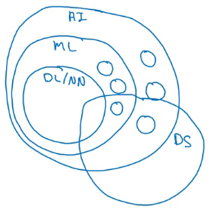
AI and related disciplines
Machine Learning
Data Science
Deep Learning / Neural Network
Supervised Learning
Unsupervised learning
Reinforcement Learning

Slide 5
Artificial Intelligence
Symbolic A.I / Classical Programming
Machine Learning
Deep Learning

Slide 6
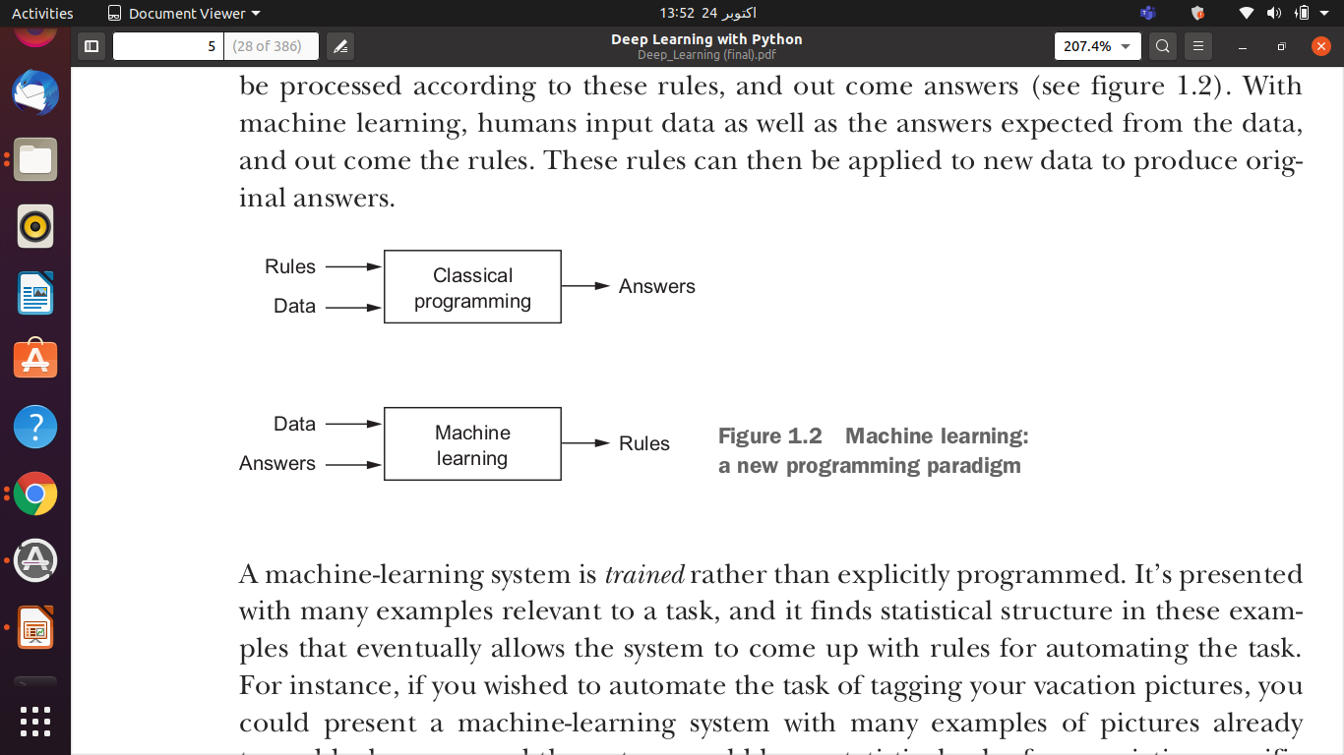
Artificial Intelligence
Symbolic A.I / Classical Programming

Slide 7
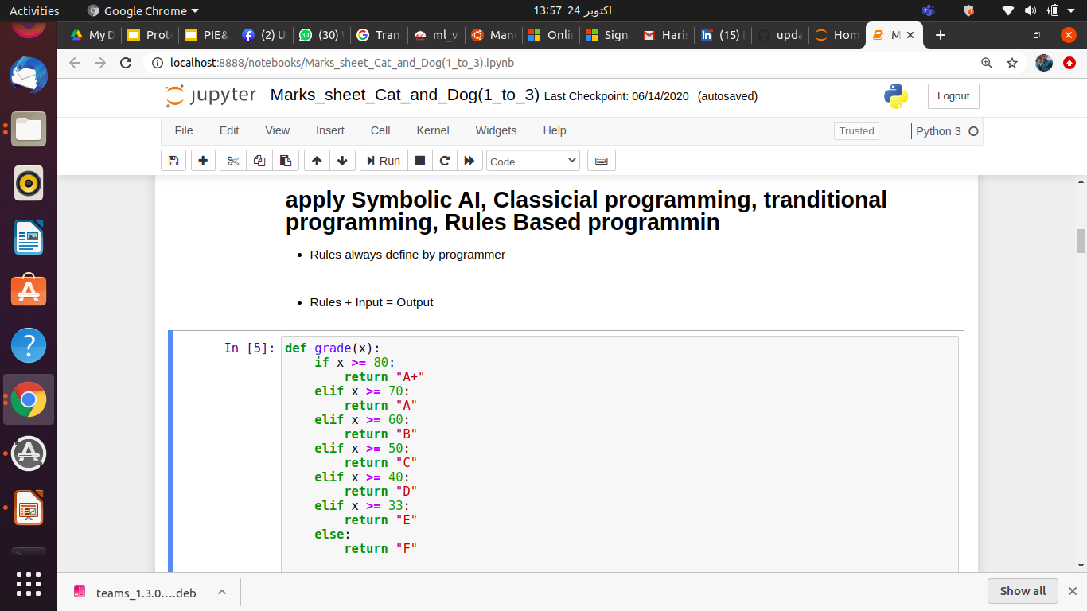
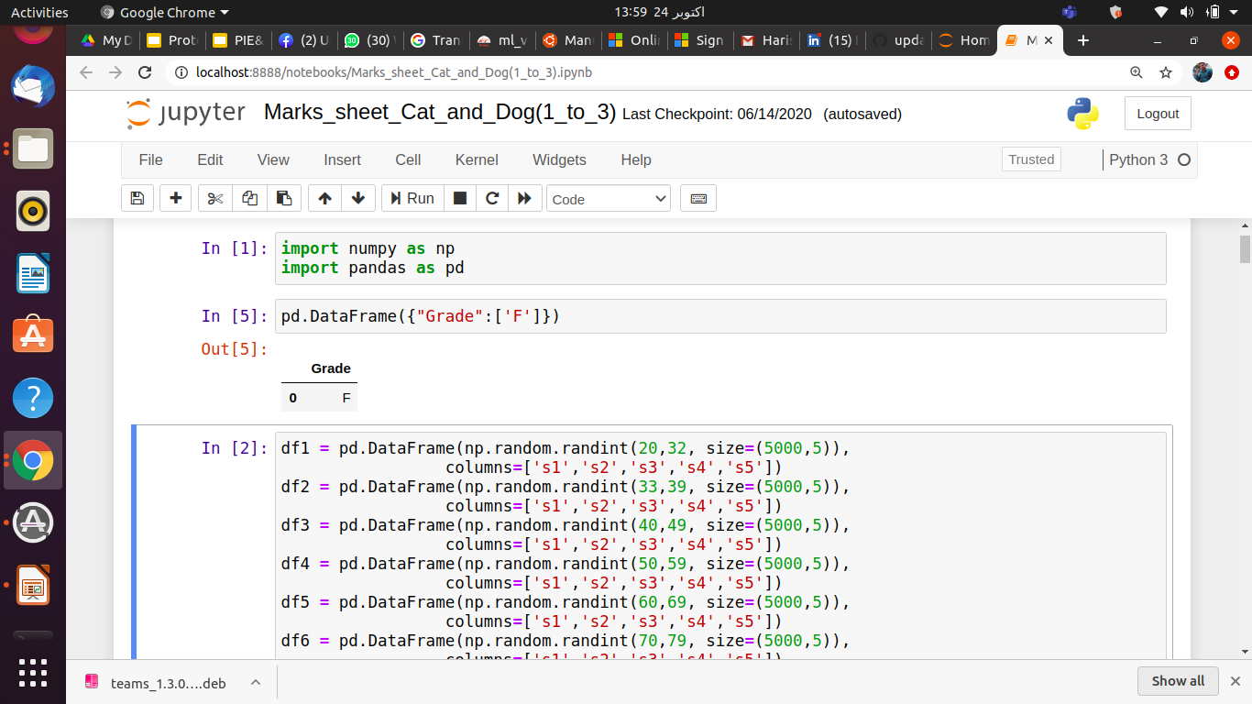
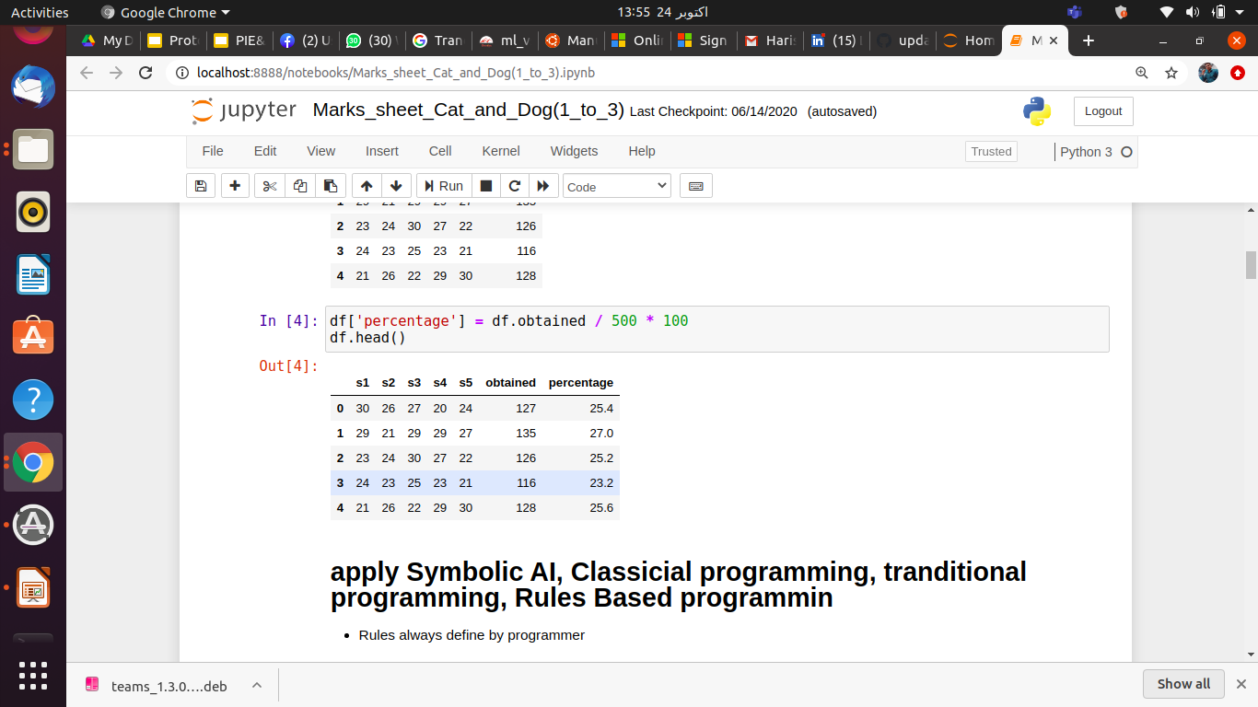
Artificial Intelligence
Symbolic A.I / Classical Programming
Output
Input

Slide 8
Artificial Intelligence
Machine Learning
There are lots of Algorithms like: (Naive Bayes, Decision Tree, Random Forest etc.
Deep Learning
Feature Engineering will be Automated
Always Use Neural Network

Slide 9
Artificial Intelligence
Machine Learning
Deep Learning

Slide 10
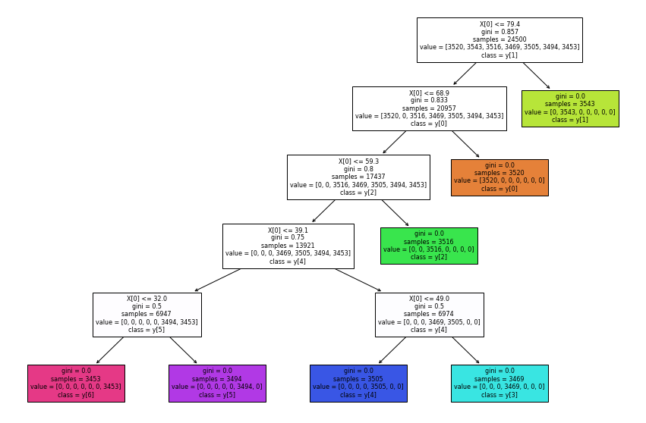
Artificial Intelligence
Machine Learning Get Rules from ML

Slide 11
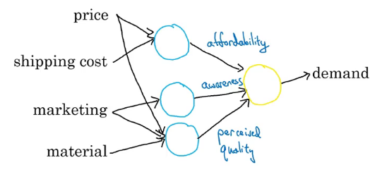
Artificial Intelligence
Deep Learning
Feature Engineering should be Auto
Always use Neural Network

Slide 12
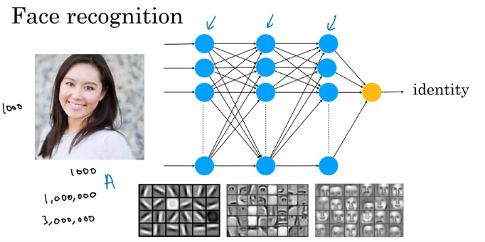
Artificial Intelligence
Deep Learning
Feature Engineering will be Automated
Always use Neural Network

Slide 13
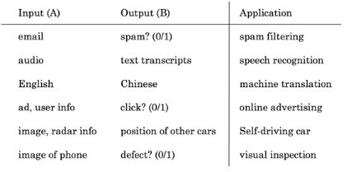
Supervised learning tasks

Slide 14

Learning Types in AI
Supervised learning tasks

Slide 15
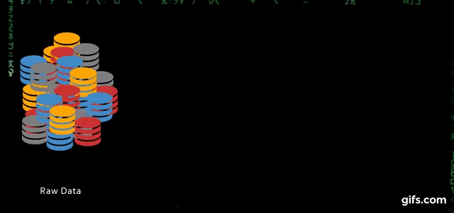
Learning Types in AI
Unsupervised learning tasks

Slide 16
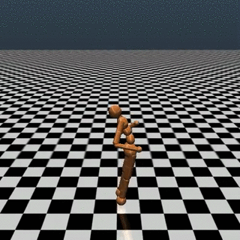

Learning Types in AI
Reinforcement learning tasks

Slide 17
Advanced Topics in Deep Learning

Slide 18
Introduction
47% of Jobs Will Disappear in the next 25 Years, According to Oxford University
More jobs will be created by AI than will be lost to it
Artificial Intelligence Market Size Worth $733.7 Billion By 2027
AI is the new electricity
“We’re about to face labor displacement of a magnitude we haven’t seen since the 1930s” – Andrew Ng
World Economic Forum: automation will displace 75 million jobs but generate 133 million new ones worldwide by 2022.

Slide 19
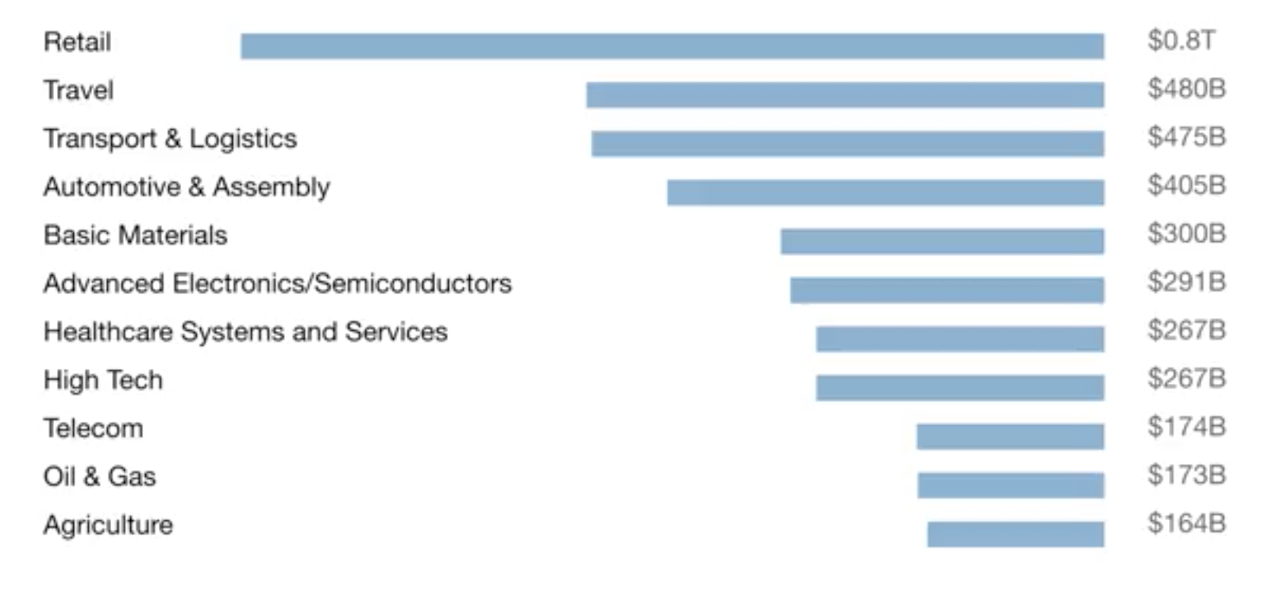
AI Market Value
$13 Trillion AI value creation by 2030

Slide 20
AI acquisitions in 2020
Apple Acquired Xnor.ai
NVIDIA Bought Mellanox
Amazon Bought Zoox
Snap Acquired AI Factory
Accenture Acquires Byte
Brillio Acquires Cognetik
Microsoft Acquired Softomotive
Intel Bought Startup Moovit

Slide 21
AI disciplines
Machine Learning
Data Science
Deep Learning / Neural Network
Supervised Learning
Un supervised learning
Reinforcement Learning

Slide 22
Convolutional Neural Network
Convolutional Neural Networks (ConvNets or CNNs) are a category of Neural Networks that have proven very effective in areas such as image recognition and classification.
ConvNets have been successful in identifying faces, objects and traffic signs apart from powering vision in robots and self driving cars.
Very similar to ordinary ANN
ConvNet architectures make the explicit assumption that the inputs are images, which allows us to encode certain properties into the architecture.

Slide 23
Layers of CNN
A simple ConvNet is a sequence of layers, and every layer of a ConvNet transforms one volume of activations to another through a differentiable function.
Convolutional Layer, Pooling Layer, and Fully-Connected Layer

Slide 24

Convolution layer

Slide 25
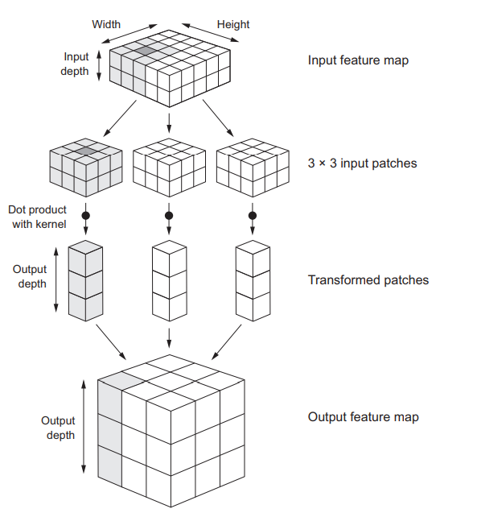
Feature Maps

Slide 26
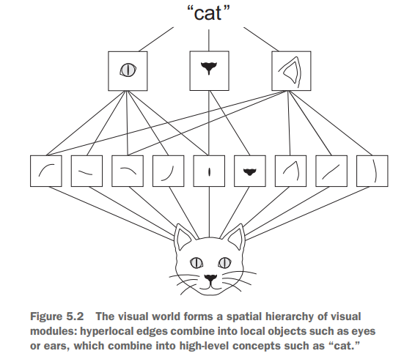
Feature extraction through layers

Slide 27
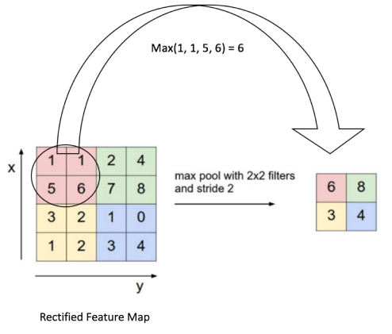
Pooling layer

Slide 28
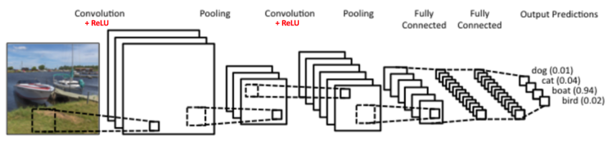
LeNet architecture

Slide 29
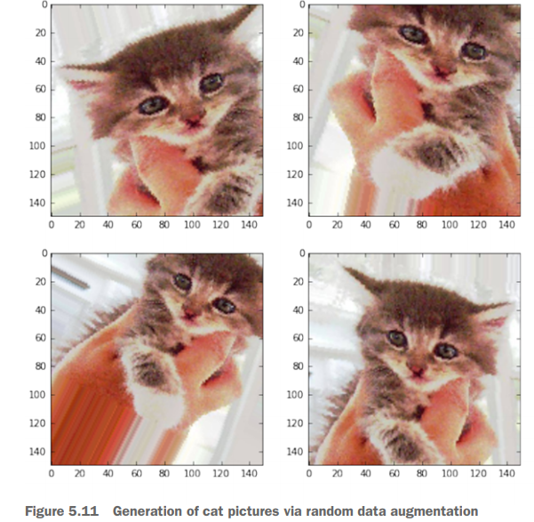
Data Augmentation

Slide 30
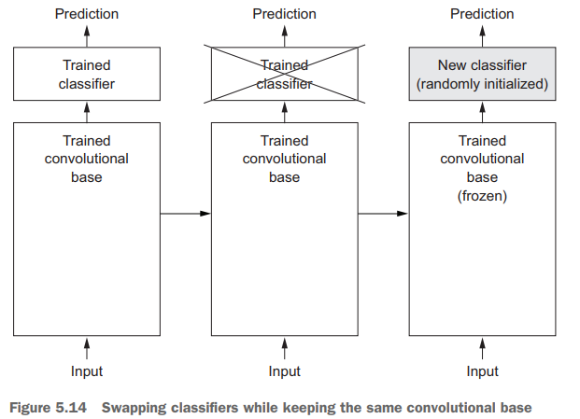
Transfer Learning

Slide 31
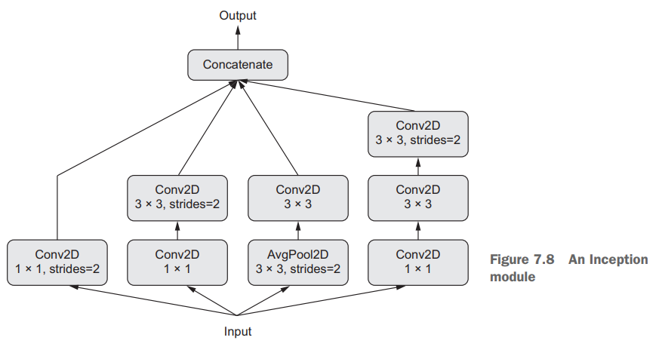
Inception

Slide 32
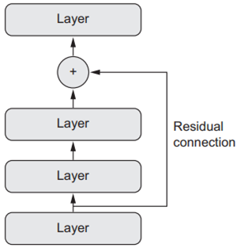
ResNet

Slide 33
Recurrent Neural Network (RNN)
A recurrent neural network (RNN) processes sequences by iterating through the sequence elements and maintaining a state containing information relative to what it has seen so far.
In effect, an RNN is a type of neural network that has an internal loop

Slide 34
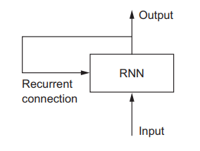
Recurrent Neural Network (RNN)

Slide 35
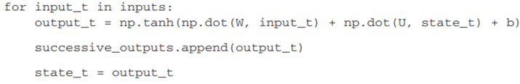
RNN pseudo-code

Slide 36
Limitations of RNN
RNN has a major issue: although it should theoretically be able to retain at time t information about inputs seen many timesteps before, in practice, such long-term dependencies are impossible to learn.
This is due to the vanishing gradient problem, an effect that is similar to what is observed with non-recurrent networks (feedforward networks) that are many layers deep: as you keep adding layers to a network, the network eventually becomes untrainable.

Slide 37
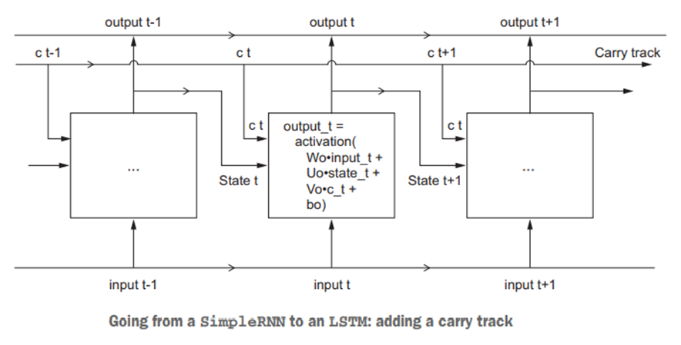

Slide 38
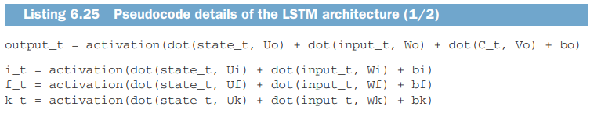
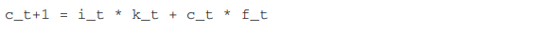
LSTM pseudo-code

Slide 39
Making a career in AI

Slide 40
Company | Deep Learning Tools
Amazon | Amazon’s Deep Scalable Sparse Tensor Network Engine (DSSTNE)
Amazon | Amazon Web Service Machine Learning API
Google | Google API
Google | Tensor Flow
Microsoft | Microsoft Distributed Machine Learning Toolkit
Microsoft | Microsoft Cognitive Toolkit
IBM | IBM Watson
Apache | Apache Spark MLlib
Samsung | Veles
Alibaba | Aliyun
Yahoo | CafeOnSpark

Slide 41
Libraries
Numpy
Pandas
Matplotlib
Scikitlearn
Tensorflow

Slide 42
Tensorflow
Python-based neural network framework
Google open source project on Github
Released November 2015
Runs highly optimized C++ code for actual calculations

Slide 43
Conclusion
CNN is the universal algorithm for computer vision
RNN and its variants are used for natural language processing tasks
Both CNN and RNN can be used for processing sequential data

Slide 44
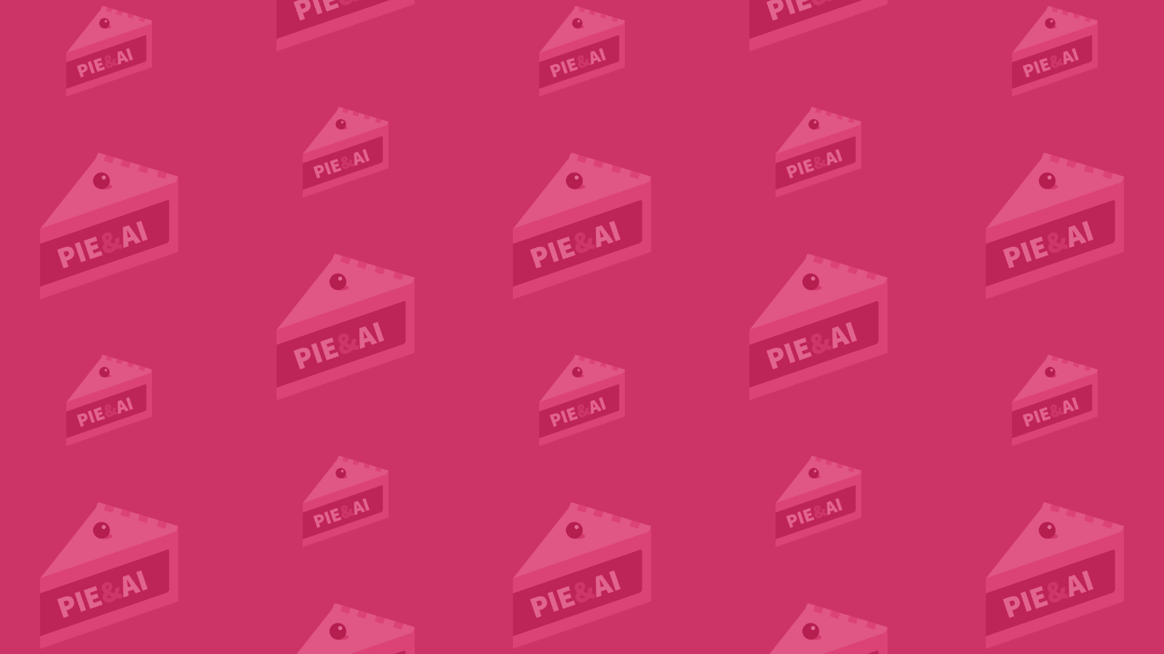
Thank You

